Slide 2
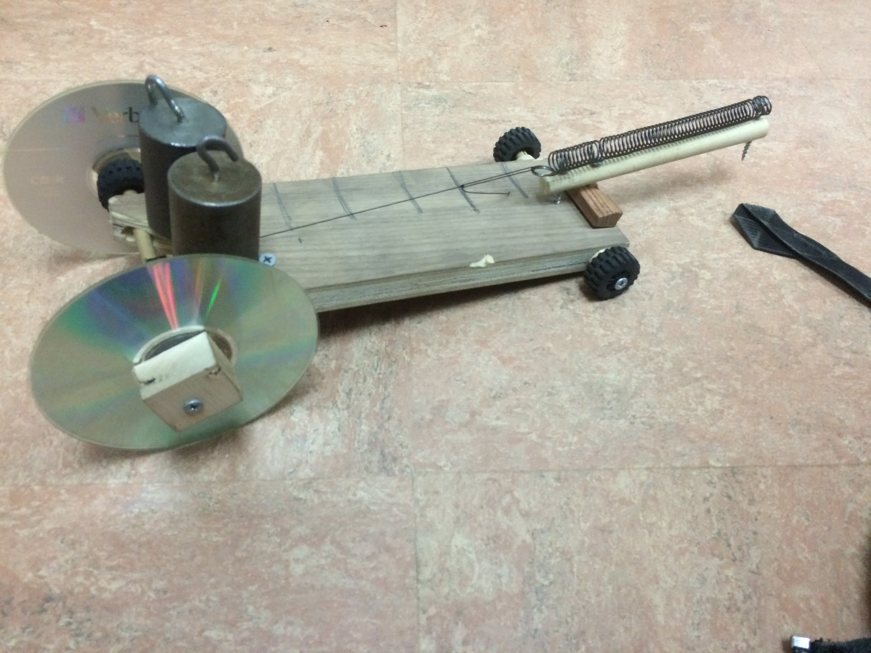
Design of the 2016 Narwhal Supersport
Materials:
2 CD’s
3 wooden dowels
Wood
Spring
Two 500g weights
Fishing Line
2 toy wheels

Slide 3
Safety
Max speed: 2.21 mph, or an astounding 371.28 mpw(miles per week), with no fatal accidents
If you do get into an accident, we will repair your car, free of charge!*
Seat belts are available upon request
*Exclusions apply-See store for details

Slide 4
Quality
Anything we make is individually inspected by a team of four brilliant engineers that made this prototype.

Slide 5
Technology
We have the newest springs that are of the finest manufacturer. Our wood producer is the finest on the planet, and our innovative wheels are cheap, durable, and easy to come by.

Slide 6
Built in USA
Our Vehicles are designed, built, and sold in
‘Murica, the land of the free, and home of the
brave.

Slide 7
Environment
There is absolutely no carbon footprint, as it is powered by a spring.

Slide 8
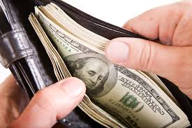
Cost
It will be extremely cheap, for any budget. It will cost a meager $20, and it requires no gas.

Slide 9
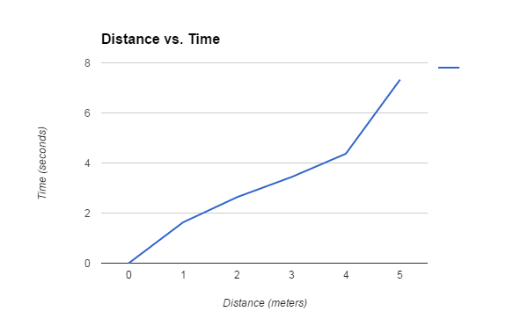
Distance

Slide 10
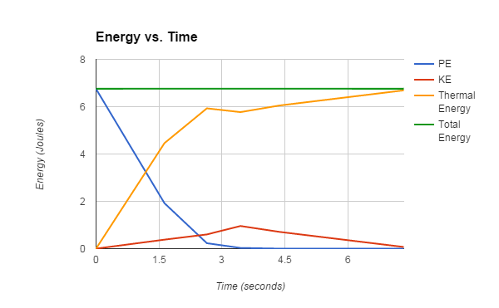
This shows that at meter 3, the energy conversion rate of potential energy to kinetic energy is an astonishing 14%. This is on average only 1% less than a typical car. For the cost, this car is definitely worth it.

