Slide 1
Reverse Engineering
LED Flashlight
By Dean Kidder-Buell, Liz King, Ben Klinge, and Austin Marr

Slide 2
Purpose of this Project
Discover in depth how a flashlight works
Practice reverse engineering methods

Slide 3
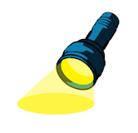
Hypothesis
Pushing button completes circuit
Turns on light
Batteries provide power source

Slide 4
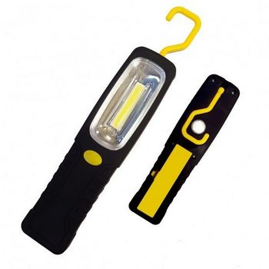
iZoom Versa Beam Utility Light
About: This unique flashlight allows for a maximum output of 112.5 Lumens, with only four triple A batteries. The additional hook creates a symbiotic relationship by adding more scenarios in which this light can be used.
Not only is this apparent, but the flashlight's discoverability is highly enhanced due to the contrasting color scheme (black and yellow), which provides the most optimal flashlight experience based on customer reviews.

Slide 5
Structure
Made of black plastic case and yellow button
Case secured by 6 screws
Clear plastic window
Silver reflector
Button

Slide 6
Exterior Components
Casing - protects inside functions and parts
polypropylene
40 MPa (maximum tensile strength) or 5801.51 PSI
Clear window - Prevents damage to LED, allows light through
Polyethylene (a common clear plastic)
20 MPa (maximum tensile strength) or 2900.75 PSI
External button cover - covers internal button for easy pushing

Slide 7
Exterior Components cont.
Magnet - allows the user to be able to stick it to metal surfaces
Screws - connects the outer shells together; nickel alloy
345 ksi (tensile strength) or 345000 PSI
Hook - gives an option to the user to hang it from a loop for hands free use (symbiotic relationship)
AAA Batteries - alkaline and steel can

Slide 8
Interior Components
Copper wires (blue & red) - allow the electric current to run from the batteries to the LED
Resistor - extends the lifespan of the lights and limits the power going to the LEDs
Reflector - Directs all light forward for maximum performance
LED - Light Emitting Diode; main function of the flashlight, provides the light for the flashlight
Aluminum gallium indium phosphide (semiconductor)
Polymethyl methacrylate (acrylic)
allows for energy efficient lighting

Slide 9
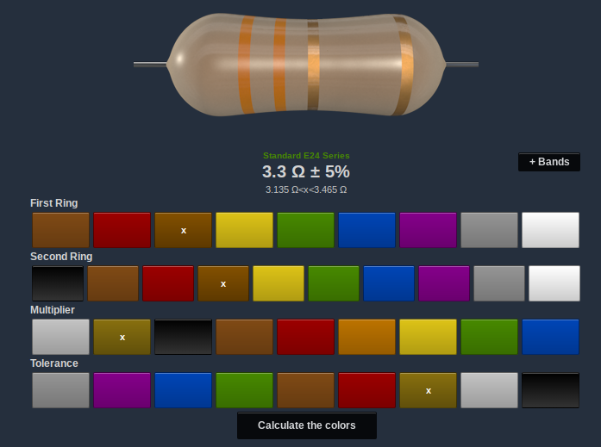
Resistor
Reduces current by 3.3k Ω±5%
Orange
Gold

Slide 10
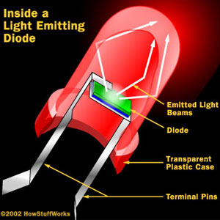
Light Emitting Diodes
Conductors made of aluminum-gallium-arsenide, a material that has no free electrons, because the atoms are perfectly bonded to each other.
This material can be “doped” to have either extra atoms or holes that electrons can flow into. An LED contains both of these materials, called N-type and P-type, respectively.
As electrons move from N to P-type, they drop to a lower orbital, releasing energy in the form of photons.
LEDs output more lumens than regular incandescent bulbs with less energy input, making them more efficient.

Slide 11
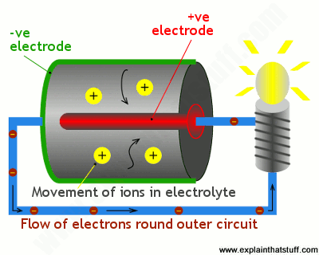
Battery Function
The flashlight converts the chemical energy of the batteries into light (electrical energy).
Positive and negative ions created
Positive ions flow into electrolyte
Negative ions flow around outside circuit (blue)
Separate reaction occurs at positive electrode which completes the circuit
Putting a bulb in this cycle creates light
This is an example of oxidation-reduction due to the flow of electrons (between the two species in the battery)
https://www.explainthatstuff.com/batteries.html

Slide 12
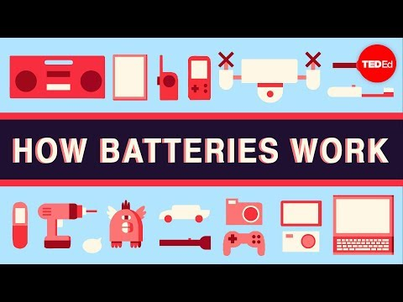
How Batteries Work - Ted-Ed
https://youtu.be/9OVtk6G2TnQ

Slide 13
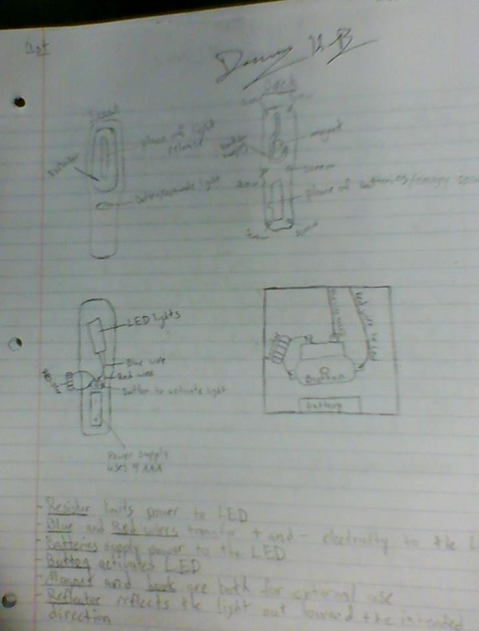
How Components Work Together
The components work together to create light. Pushing the button completes the circuit between the batteries and the 10 LEDs and allows the current to reach each LED. The resistor prolongs the life of the light by limiting the amount of current that flows into it. The wires allow the electrical current to travel to the LEDs. The plastic reflector enhances the reach of the light, the plastic window protects it, and the plastic casing keeps the flashlight together in one, easy-to-use piece.

Slide 14
Flow Chart
Button is pushed
Battery (power)
LED
Electrical current
Light!
Wire
Resistor

Slide 15
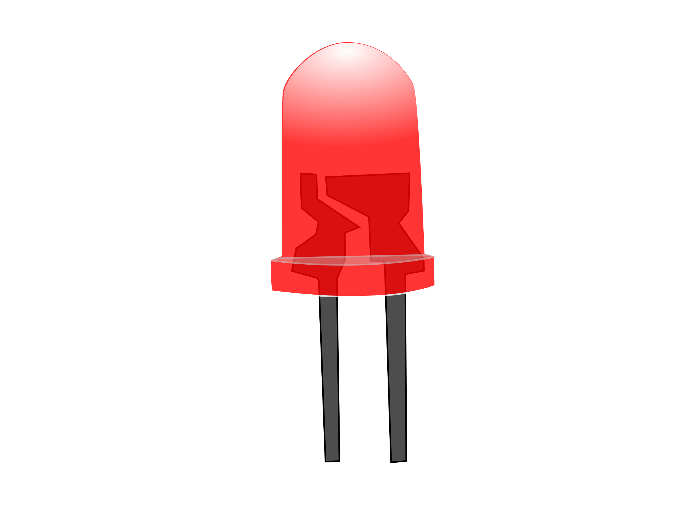
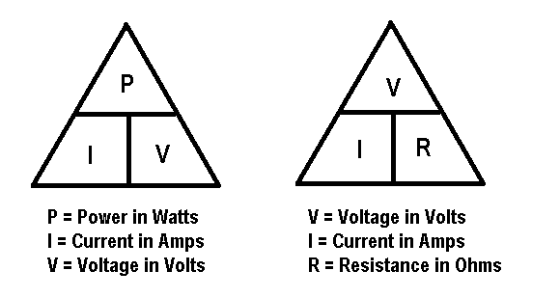
Calculations
I=V/R
I= 6V/3.3kΩ
I= 1.82 mA
P=IV
P= 0.00182A*6V
P= 0.011 W

Slide 16
Manufacturing
iZoom products
Designed in U.S.
Manufactured in China
Assembly line
West Coast Imports
Commerce, CA
Sell a variety of products made by other companies
iZoom, Tool Solutions, Geek Tek, etc.

Slide 17
Email to West Coast Imports and Supplier
Hello,
We are students at San Marin High School in their engineering class. For one of our projects we have to take apart and analyze in depth an object. Our group's object is your iZoom Versa Beam Utility Light. We were unable to find a description of the materials used online anywhere, so we wondering if you could tell us what types of plastic were used for the light, including the case, clear window, and reflector.
Thank you,
Dean Kidder-Buell, Liz King, Ben Klinge, and Austin Marr

Slide 18
Hypothesis Check
After doing this project, we found out that our hypothesis was correct because all of the following occurred.
Pushing button completes circuit
Turns on light
Batteries provide power source

Slide 19
Works Cited
http://www.cookbrothers.com/product-page.cfm?productno=45222
https://www.jameco.com/Jameco/workshop/circuitnotes/circuit-notes-resistors.html
http://www.madlab.org/electrnx/lesson2.html
https://www.ledsmagazine.com/articles/2004/01/what-is-an-led.html
https://www.explainthatstuff.com/batteries.html
http://resistor.cherryjourney.pt/
http://www.wciimports.com/
https://youtu.be/9OVtk6G2TnQ

