Slide 1
Rube Goldberg Machine
PRESENTED BY: DEAN KIDDER-BUELL, LIZ KING, BENJAMIN KLINGE, MARILYNN HUNT

Slide 2
Step one
Velocity=change of distance/change of time
=1.15 m/s
The average velocity of the marble down the screw is 1.15 m/s.

Slide 3
STEP 2
Mechanical advantage=number of pulleys
MA= 1
force effort = force load

Slide 4
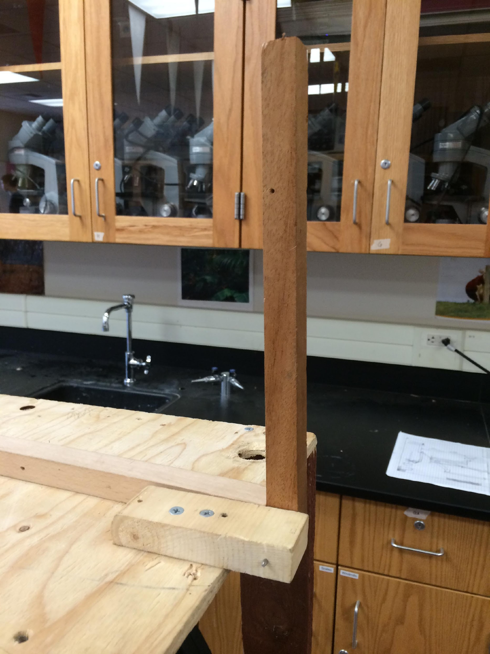
STEP 3
Work=change in potential energy=
change in kinetic energy= energy
transferred
=0.13J
The total energy transferred from our hammer to our small marble is 0.13J

Slide 5
STEP 4
Change in Kinetic Energy = Change in Potential Energy
=0.56J
The kinetic energy of our marble at the end of the inclined plane is 0.56J

Slide 6
STEP 5
Ideal Mechanical Advantage is equal to the distance of the effort from the fulcrum over the distance of the load from the fulcrum.

Slide 7
STEP 6
Toppling works by the center of gravity of an object being forced over the edge of the bottom. When is reaches this point, it falls over.

Slide 8
STEP 7
+

Slide 9
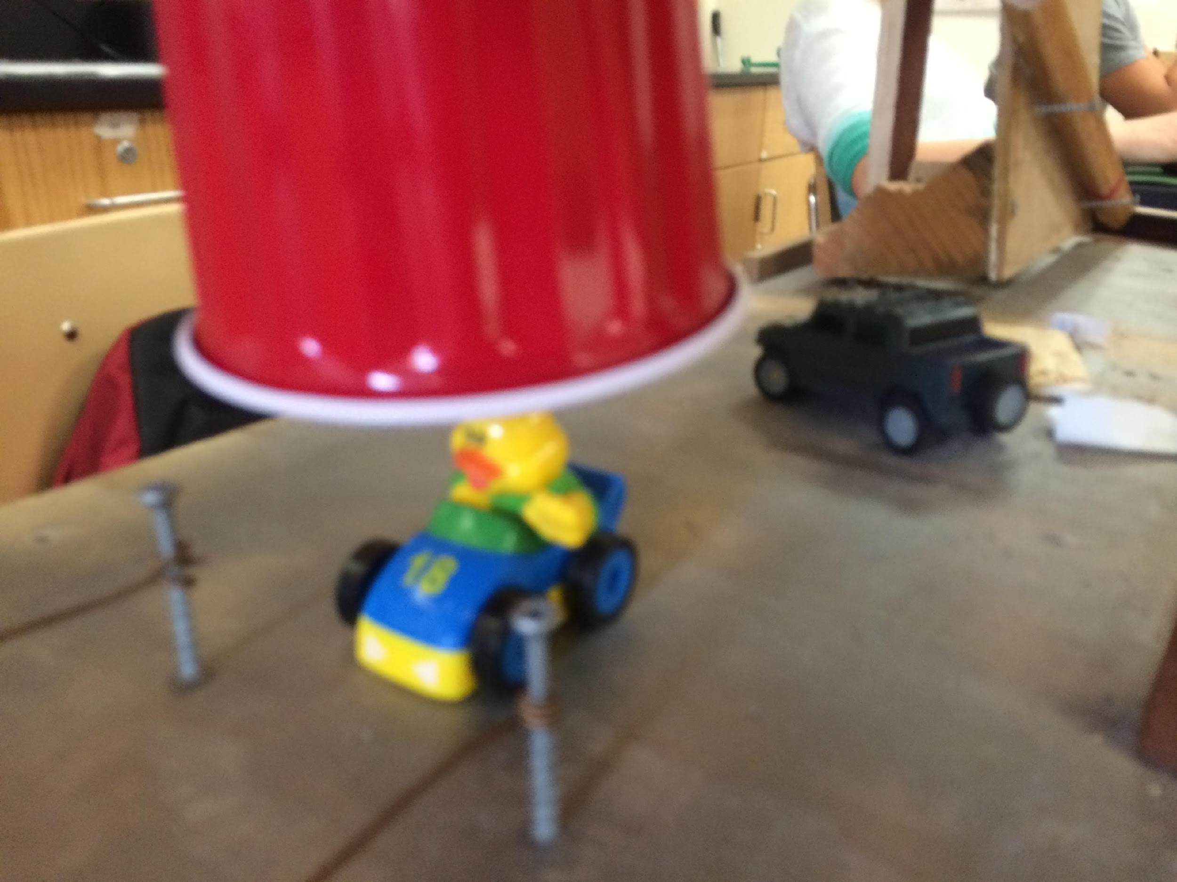
STEP 8

Slide 10
STEP 9

Slide 11
STEP 10

